Slide 1
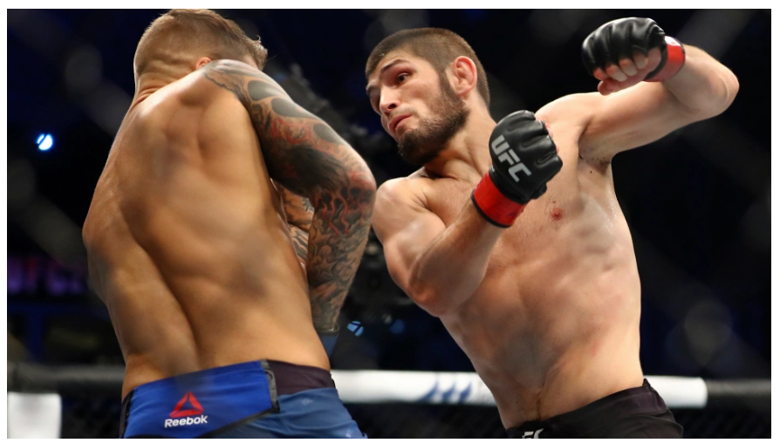
UFC Data Solutions in Action
Jeffrey Dean

Slide 2


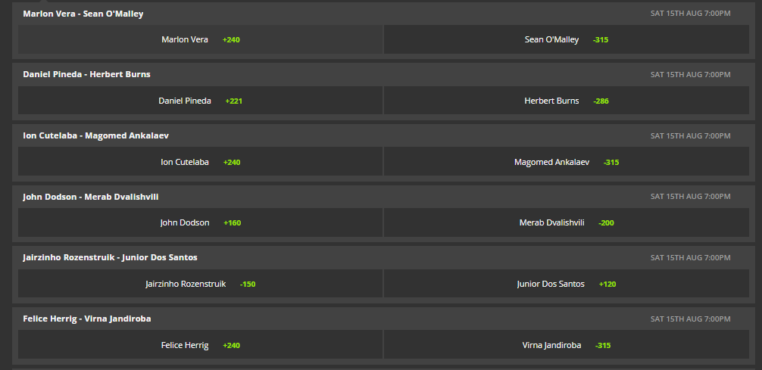

Why I’m Here
Do you want to win bets with friends on UFC?
Do you want to bet and have a million options?
Do you find the moneyline a bit overwhelming?

Slide 3
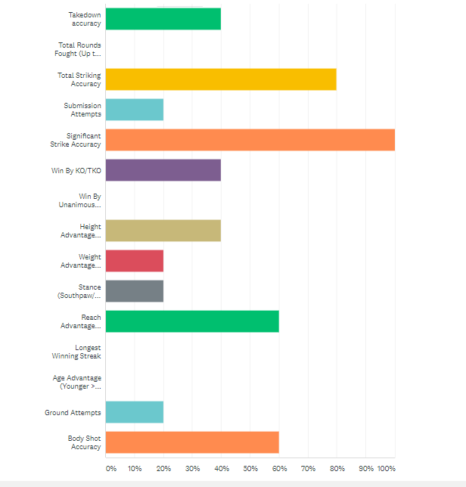
Data… Data Everywhere
There exists hundreds, if not thousands of potential data points a person can analyze, but where to start?
To gauge opinions, I polled consistent UFC fight viewers to see what they think matters.

Slide 4

The Goals
Find simple statistics
Find ANOVA/regression models
Develop profile compilation tools for potential bettor

Slide 5
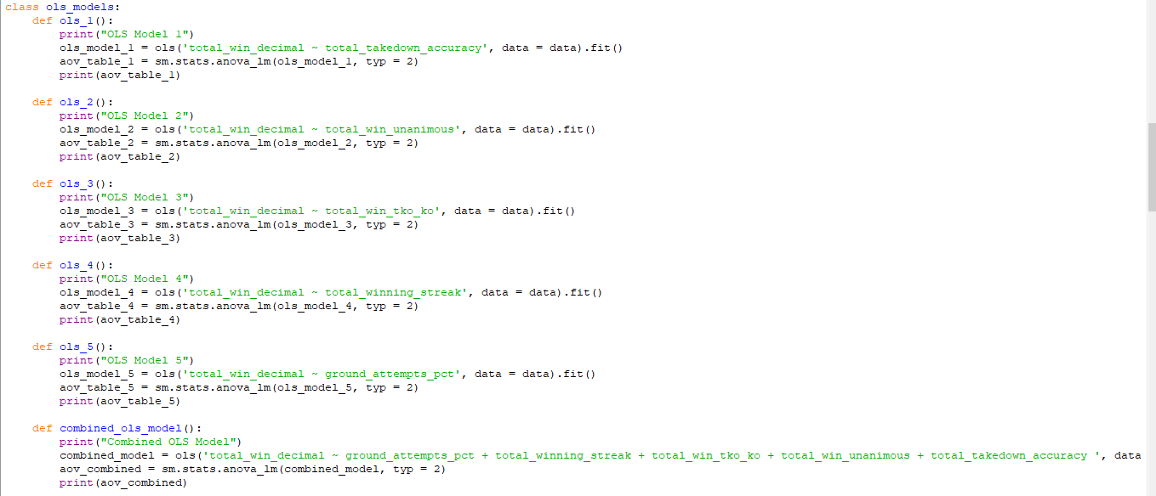
Method 1: Find Significance
OLS Models are considered good standard practice for finding statistical significance. 5% threshold for passing a test.

Slide 6
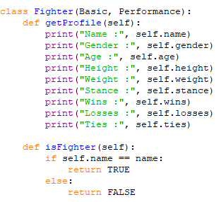
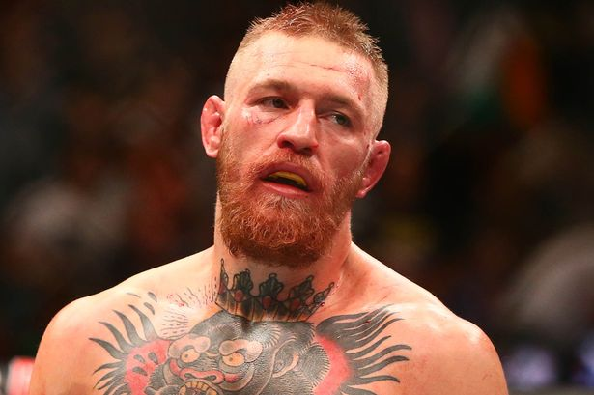
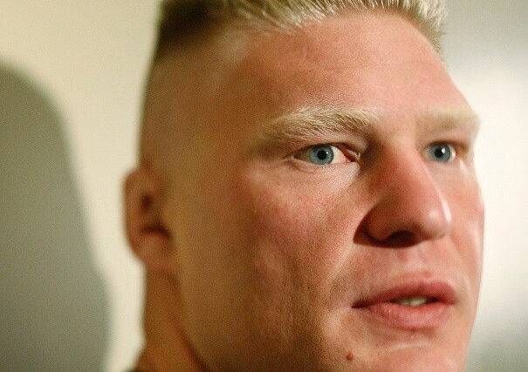

Method 2: Build a Profile
Code developed allows a user to efficiently insert and retrieve data that can be utilized to track and follow their favorite UFC contestants. Create and customize a profile that suits your needs

Slide 7
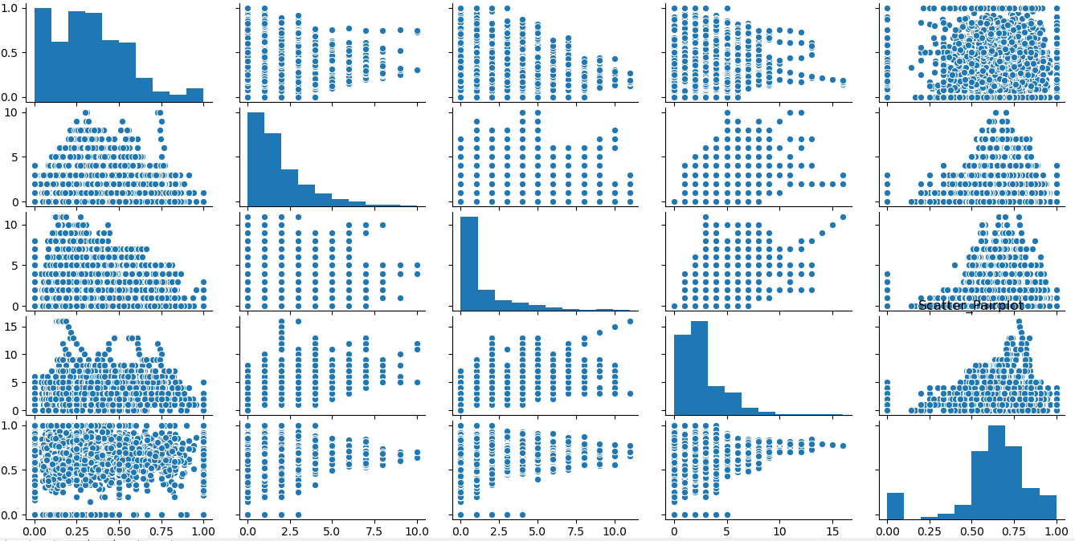
Graphs in Action
Visuals for reference in conjunction with OLS results. Each graph is paired with the x axis representing the factor and y axis as the win rate. Analysis is needed to determine which of these is valuable to explore.

Slide 8
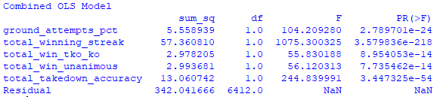
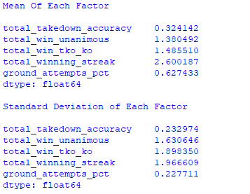
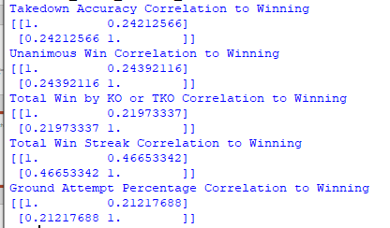
Method Results: Stats/ANOVA
Code developed shows where significance occurs. The tests support five clear indicators with strong statistical significance (t statistics/ f statistic)

Slide 9
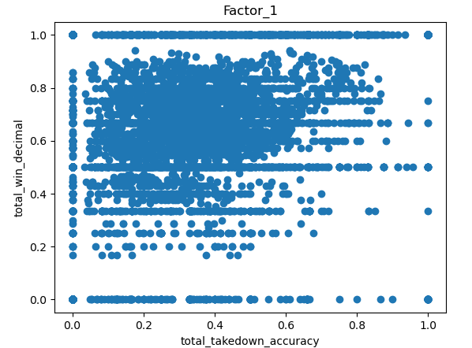
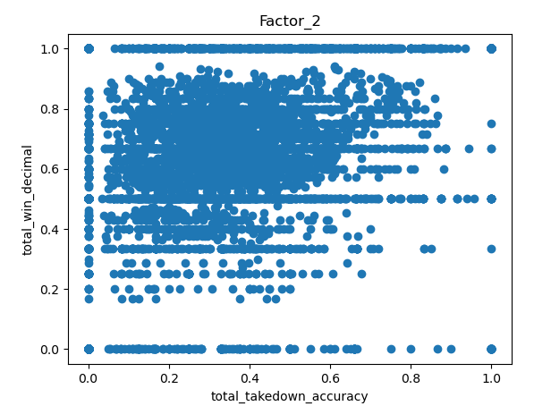
Graphs of Significant Factors Part 1

Slide 10
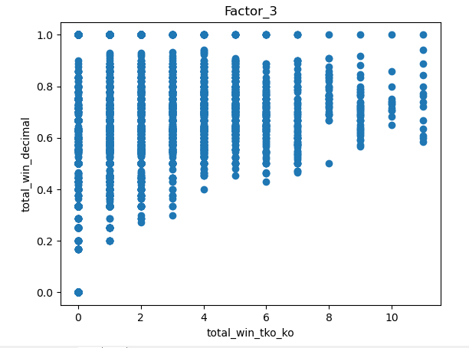
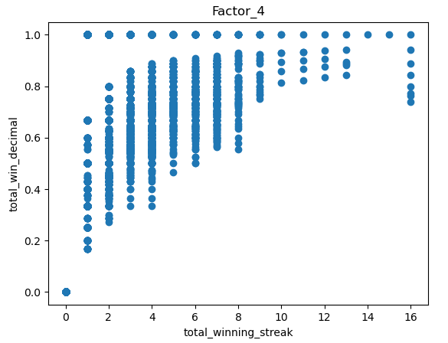
Graphs of Significant Factors Part 2

Slide 11
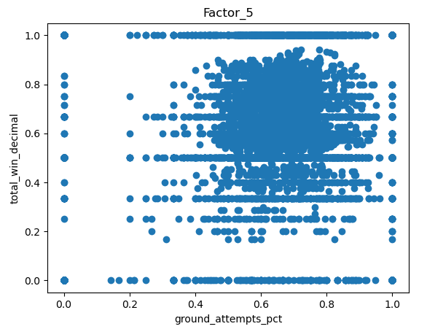
Graphs of Significant Factors Part 3

Slide 12

Where To Go From Here
Endless possibility to expand models:
-more data
-investigate each weight class
-investigate differences in gender
With the code given here anything is possible. Get the most from what the data can tell you!

